Slide 1
Decorator Design Pattern
By
Team 12-1
Sayed Khushal Shah (34)
Zeenat Tariq (42)

Slide 2
Decorator Design Pattern
The Decorator pattern extends (decorates) an object’s behavior dynamically
The ability to add new behavior at runtime is accomplished by a Decorator object which ‘wraps itself’ around the original object

Slide 3
Story
The decorator design pattern can be explained with the help of Human Resource Management for Company
For employee salary, we can append employee object with salary information
All salary records can be updated and viewed

Slide 4
UML Design
Component – represents the base type of the actual or the concrete type
Concrete Component -- represents the concrete type that extends the base component
Decorator -- represents a reference to a component. The dynamic functionalities are added in this type

Slide 5
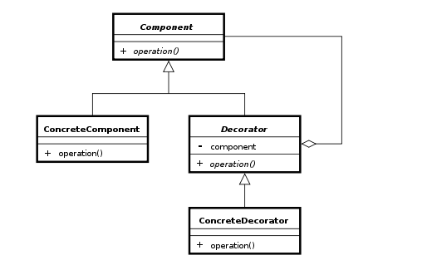
Contd..

Slide 6
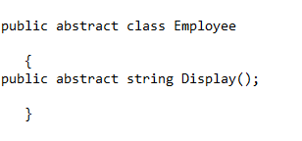
Code

Slide 7
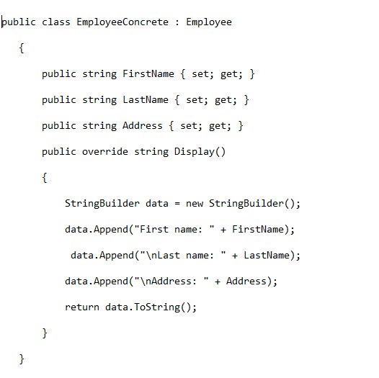
Concrete Class

Slide 8
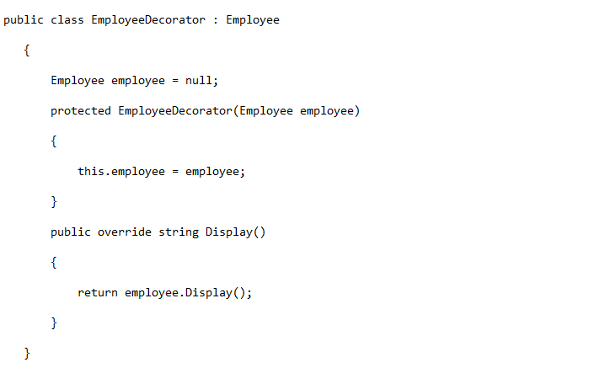
Employee Decorator

Slide 9
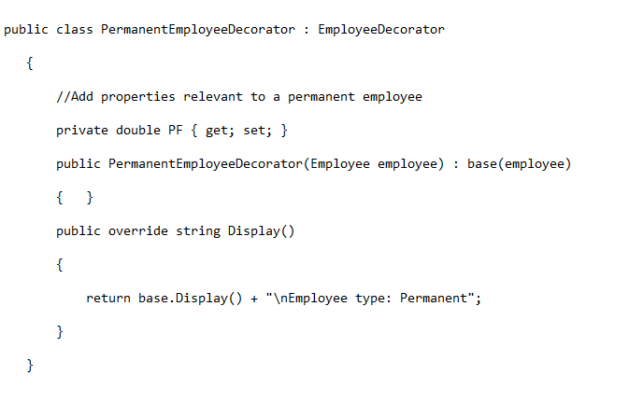
Concrete Decorator

Slide 10
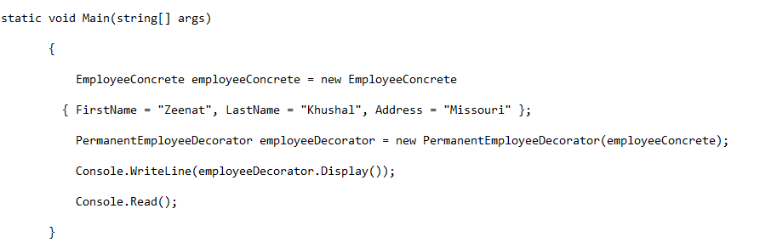
Instance of Concrete Class

Slide 11
Quiz
Explain the Decorator Design Pattern?
How decorator pattern allows a user to add new functionality to an existing object without altering its structure?
Name four types of Design Patterns and also explain the difference between prototype pattern and decorator design pattern?

